Slide 1
Probability Modeling of Linear Regression

Slide 2
Lecture Outline
Probability Review
Binomial Distribution
Normal Distribution
Modeling Data with Probability Distributions
Likelihood Theory
Modeling Linear Regression Probabilistically
statmodels

Slide 3
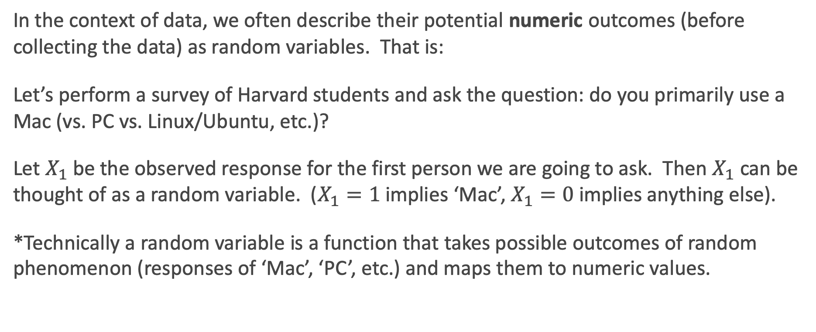
What is a random variable?
In the context of data, we often describe their potential numeric outcomes (before collecting the data) as random variables. That is:
Let’s perform a survey of Harvard students and ask the question: do you primarily use a Mac (vs. PC vs. Linux/Ubuntu, etc.)?
Let $X_{1}$ be the observed response for the first person we are going to ask. Then $X_{1}$ can be thought of as a random variable. ($X_{1}=1$ implies ‘Mac’, $X_{1}=0$ implies anything else).
*Technically a random variable is a function that takes possible outcomes of random phenomenon (responses of ‘Mac’, ‘PC’, etc.) and maps them to numeric values.

Slide 4
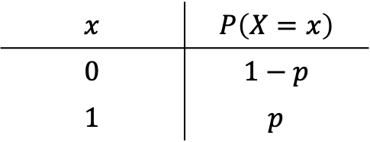
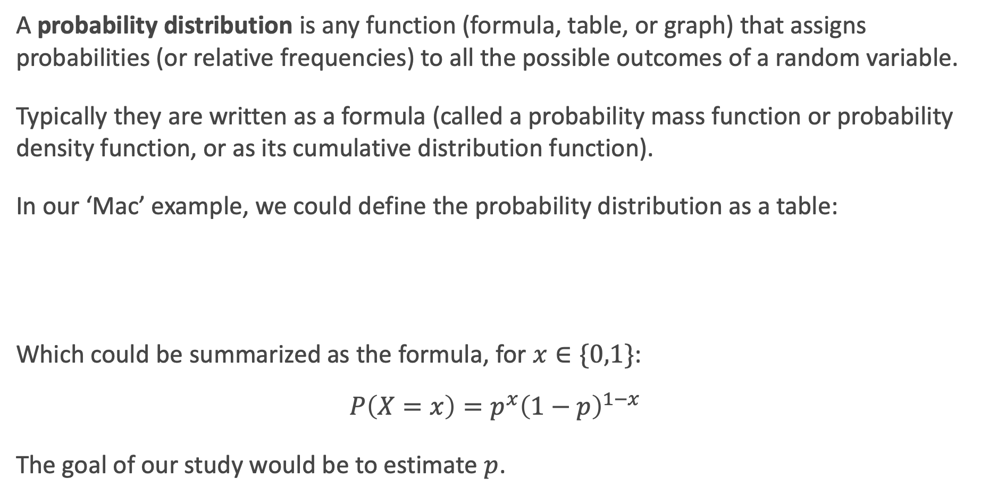
What is a probability distribution?
A probability distribution is any function (formula, table, or graph) that assigns probabilities (or relative frequencies) to all the possible outcomes of a random variable.
Typically they are written as a formula (called a probability mass function or probability density function, or as its cumulative distribution function).
In our ‘Mac’ example, we could define the probability distribution as a table:
Which could be summarized as the formula, for $x∈\{0,1\}$:
$$P\left(X=x\right)=p^{x}{\left(1−p\right)}^{1−x}$$
The goal of our study would be to estimate $p$.
$$x$$ | $$P\left(X=x\right)$$
$$0$$ | $$1−p$$
$$1$$ | $$p$$

Slide 5
Discrete vs. Continuous
There are two major types of random variables: discrete (can only take on specific values) and continuous (can take on any value within a range).
The probability distribution function is defined differently for these two types:
A probability mass function (PMF) is a function that gives the probability of getting a specific value for a discrete random variable.
A probability density function (PDF) is a function that gives the relative likelihood of a specific value for a continuous random variable (the height of the curve).
*Note: probabilities for a continuous random variable can be represented as areas under the curve, and thus P(X = x) = 0 since there is no width.

Slide 6
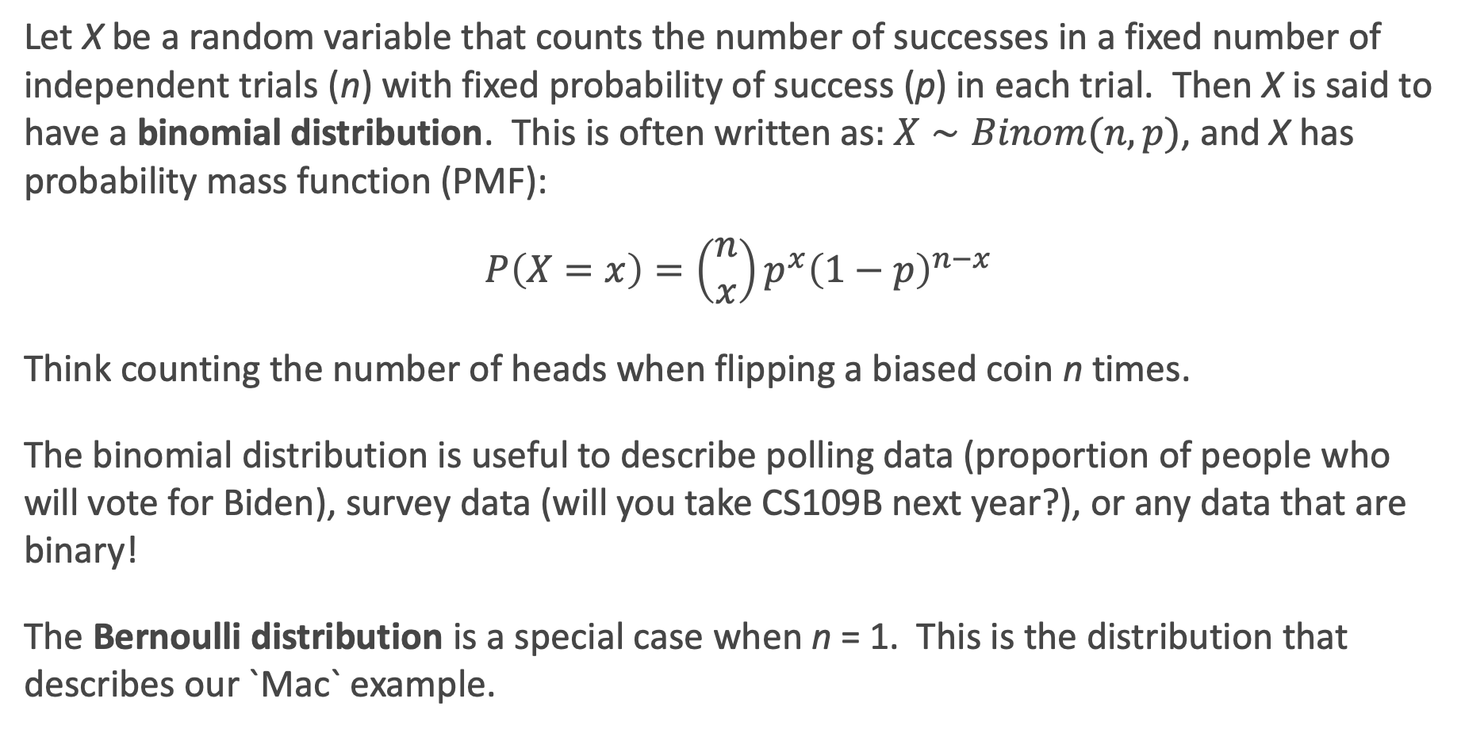
The Binomial Distribution
Let X be a random variable that counts the number of successes in a fixed number of independent trials (n) with fixed probability of success (p) in each trial. Then X is said to have a binomial distribution. This is often written as: $X∼Binom(n,p)$, and X has probability mass function (PMF):
$$P\left(X=x\right)=\left(\begin{matrix}n \\ x\end{matrix}\right)p^{x}{\left(1−p\right)}^{n−x}$$
Think counting the number of heads when flipping a biased coin n times.
The binomial distribution is useful to describe polling data (proportion of people who will vote for Biden), survey data (will you take CS109B next year?), or any data that are binary!
The Bernoulli distribution is a special case when n = 1. This is the distribution that describes our `Mac` example.

Slide 7

Binomial Distribution Examples
A binomial distribution has mean $np$ and standard deviation $\sqrt{np(1−p)}$.

Slide 8
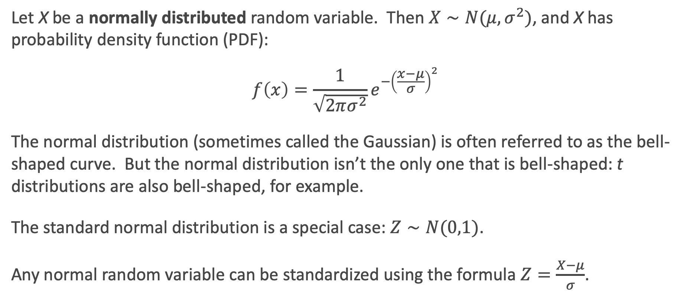
The Normal Distribution
Let X be a normally distributed random variable. Then $X∼N(μ,σ^{2})$, and X has probability density function (PDF):
$$f\left(x\right)=\frac{1}{\sqrt{2πσ^{2}}}e^{−{\left(\frac{x−μ}{σ}\right)}^{2}}$$
The normal distribution (sometimes called the Gaussian) is often referred to as the bell-shaped curve. But the normal distribution isn’t the only one that is bell-shaped: t distributions are also bell-shaped, for example.
The standard normal distribution is a special case: $Z∼N(0,1)$.
Any normal random variable can be standardized using the formula $Z=\frac{X−μ}{σ}$.

Slide 9

The Normal Distribution Examples
A normal distribution has mean $μ$ and standard deviation $σ$.

Slide 10

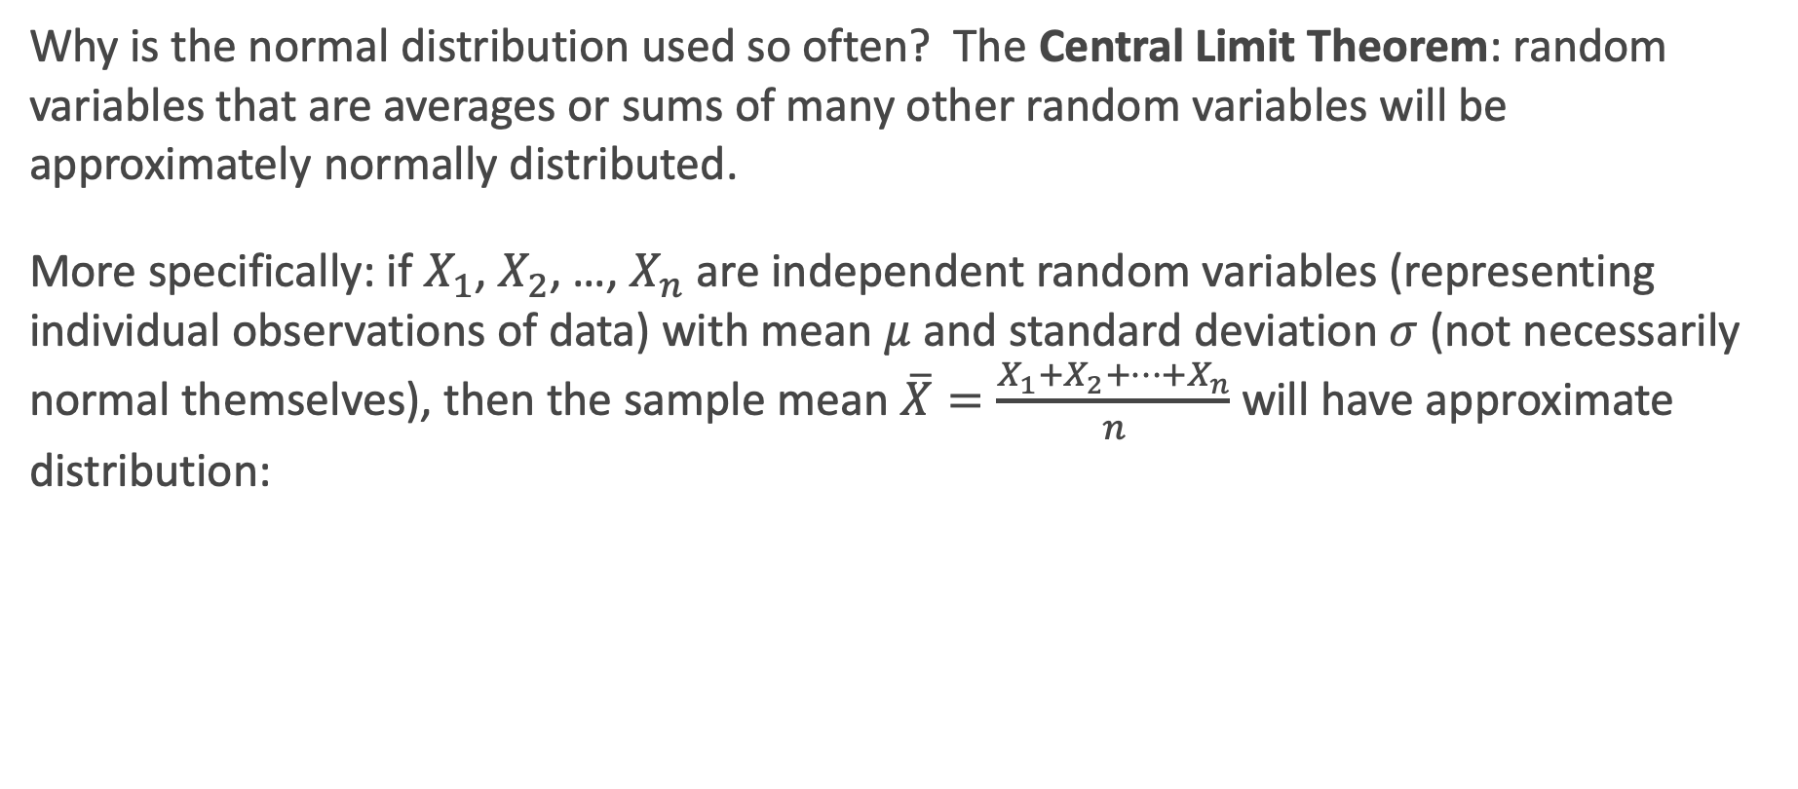
Central Limit Theorem
Why is the normal distribution used so often? The Central Limit Theorem: random variables that are averages or sums of many other random variables will be approximately normally distributed.
More specifically: if $X_{1}$, $X_{2}$, …, $X_{n}$ are independent random variables (representing individual observations of data) with mean $μ$and standard deviation $σ$ (not necessarily normal themselves), then the sample mean $\overline{X}=\frac{X_{1}+X_{2}+…+X_{n}}{n}$will have approximate distribution:
$$\overline{X}∼N\left(μ,\frac{σ^{2}}{n}\right)$$

Slide 11
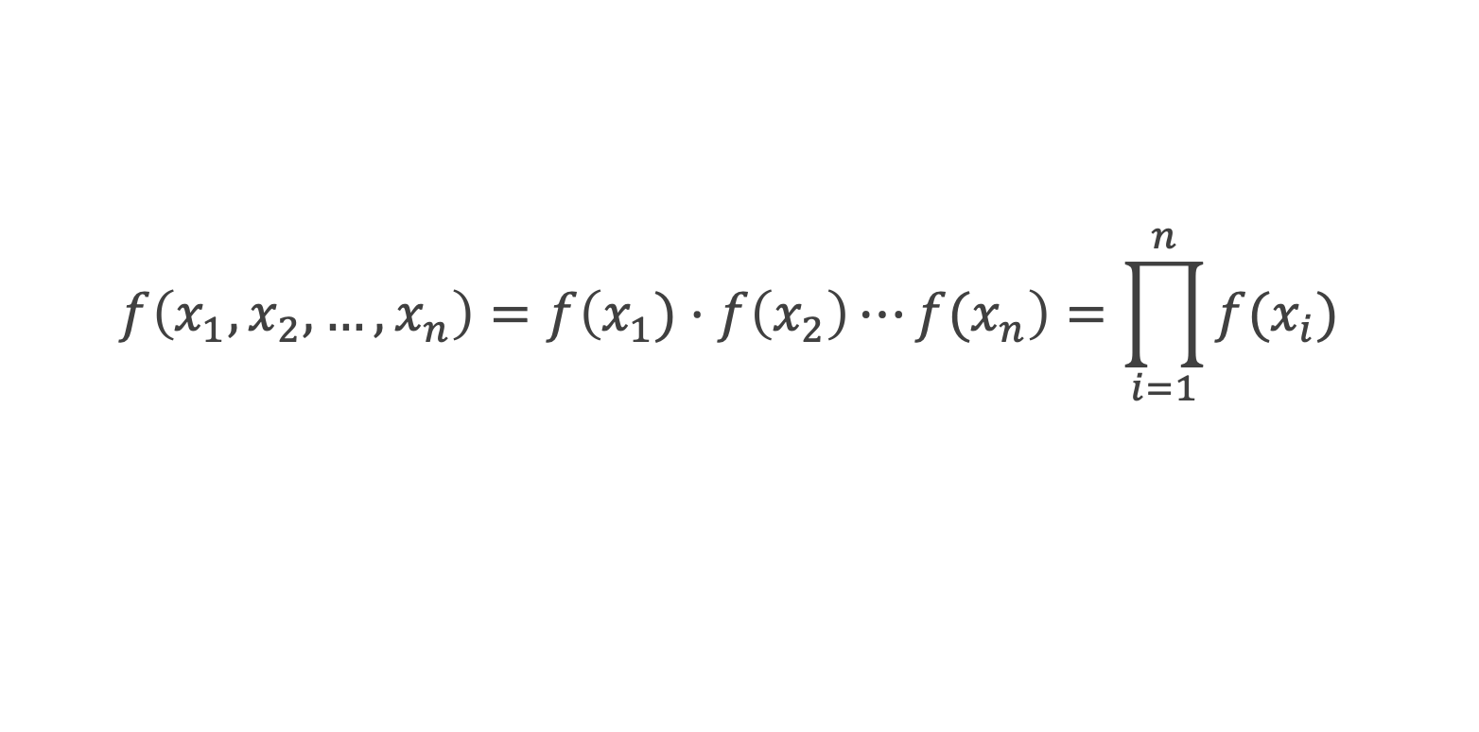

Joint Distributions
What happens to these probability distributions (PMFs and PDFs) when there are multiple random variables involved (aka, multiple observations in a data set)?
Let $f\left(x_{1},x_{2},…,x_{n}\right)$ be the joint distribution of $n$ separate random variables. If they all come from the same generative marginal distribution, $f\left(x_{i}\right)$, and are independent, what is the resulting distribution?
$$f\left(x_{1},x_{2},…,x_{n}\right)=f\left(x_{1})⋅f\left(x_{2}\right)⋯f(x_{n}\right)=\prod_{i=1}^{n}{f(x_{i})}$$

Slide 12
Modeling Data with Probability Distributions

Slide 13
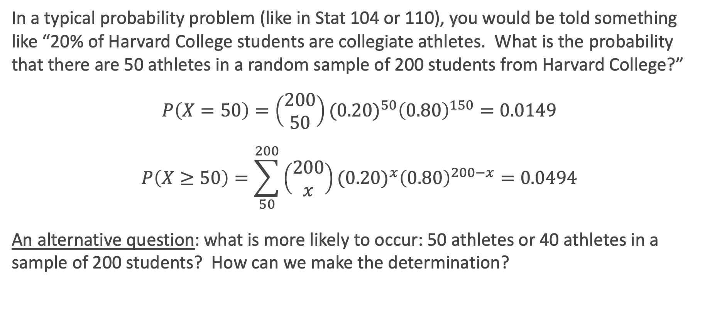
The Probability of Data
In a typical probability problem (like in Stat 104 or 110), you would be told something like “20% of Harvard College students are collegiate athletes. What is the probability that there are 50 athletes in a random sample of 200 students from Harvard College?”
$$P\left(X=50\right)=\left(\begin{matrix}200 \\ 50\end{matrix}\right){(0.20)}^{50}{\left(0.80\right)}^{150}=0.0149$$
$$P\left(X≥50\right)=\sum_{50}^{200}{\left(\begin{matrix}200 \\ x\end{matrix}\right){(0.20)}^{x}{\left(0.80\right)}^{200−x}}=0.0494$$
An alternative question: what is more likely to occur: 50 athletes or 40 athletes in a sample of 200 students? How can we make the determination?

Slide 14
Inference: the inverse of probability
In the last problem, how did we know that the statement “20% of Harvard College students are collegiate athletes” is accurate? Where did this come from?
In most applications, the true population parameter (here, the proportion in all of Harvard College) is unknown. What we get to observe is the data, and we want to make a statement about the unknown parameter. So a more poignant question would be:
“There are 50 athletes in a random sample of 200 students from Harvard College. Is a binomial distribution with p = 0.2 or p = 0.25 more reasonable?”
This approach of using the data to make a statement about a parameter (in a statistical model) is called inference.

Slide 15
Likelihood Theory

Slide 16
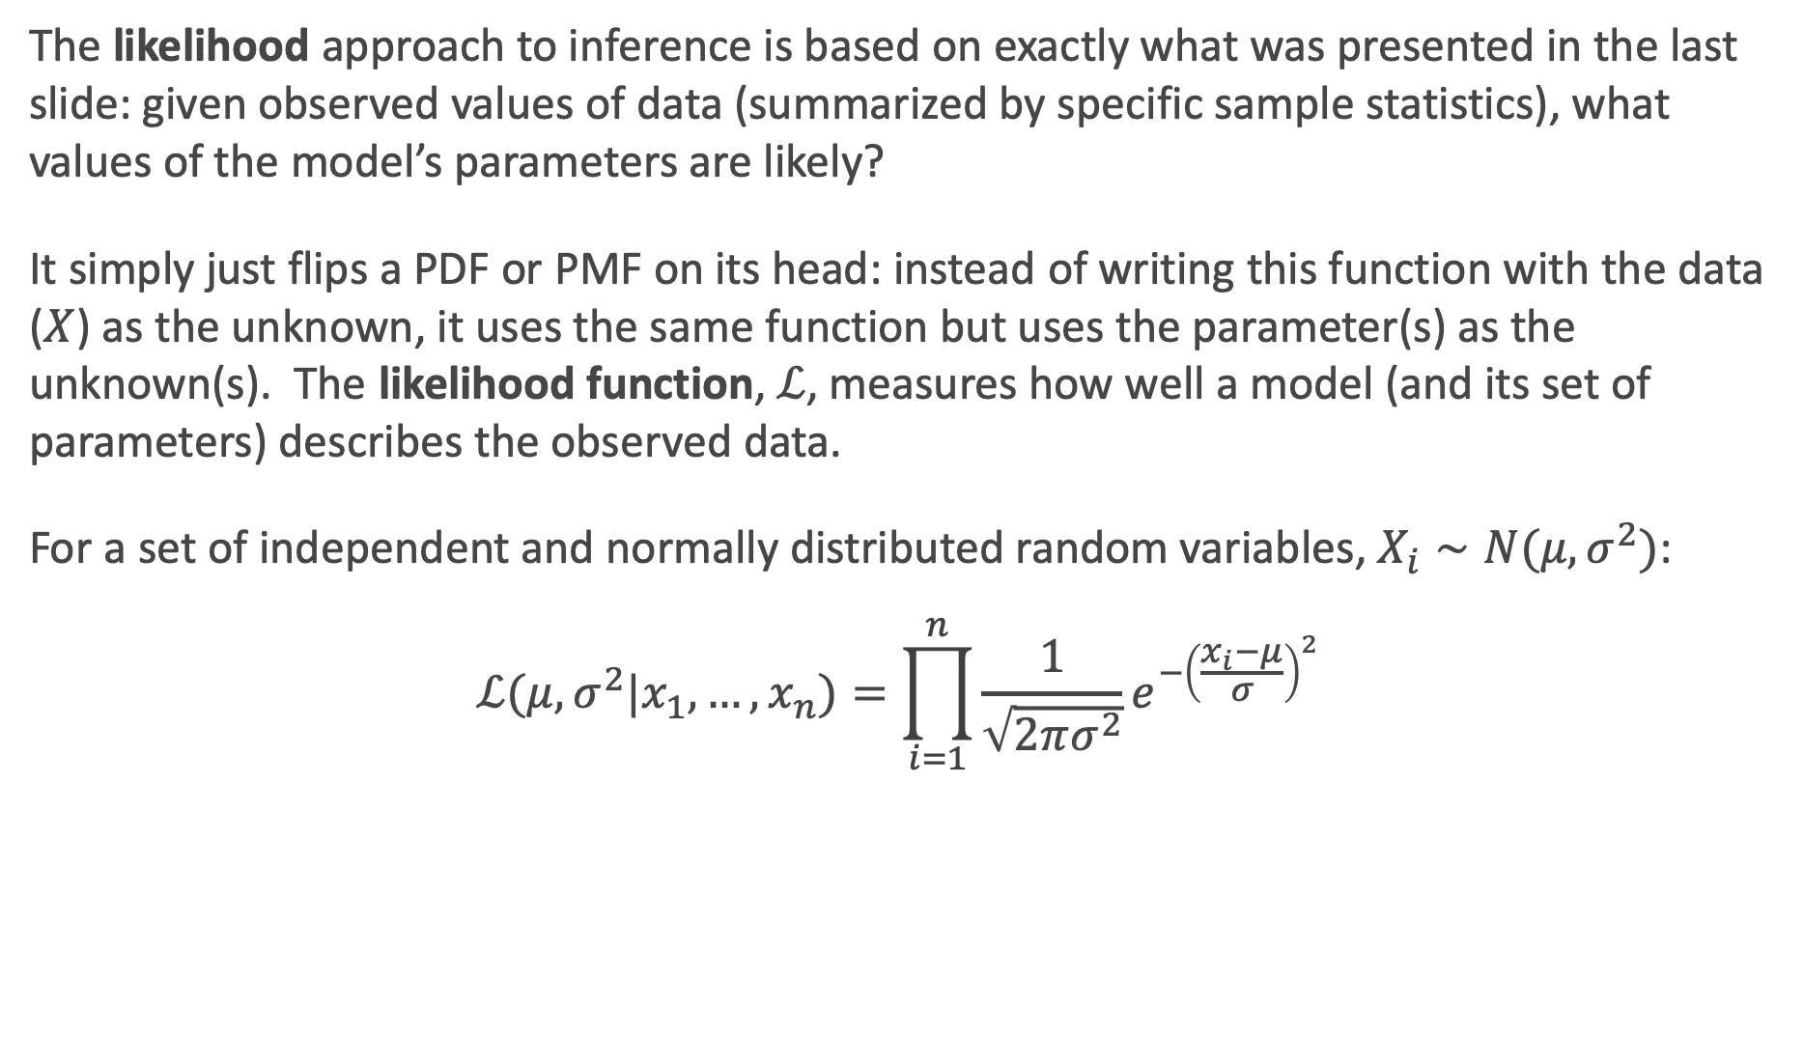
The idea of likelihood
The likelihood approach to inference is based on exactly what was presented in the last slide: given observed values of data (summarized by specific sample statistics), what values of the model’s parameters are likely?
It simply just flips a PDF or PMF on its head: instead of writing this function with the data ($X$) as the unknown, it uses the same function but uses the parameter(s) as the unknown(s). The likelihood function, $ℒ$, measures how well a model (and its set of parameters) describes the observed data.
For a set of independent and normally distributed random variables, $X_{i}∼N(μ,σ^{2})$:
$$ℒ(μ,σ^{2}|x_{1},…,x_{n})=\prod_{i=1}^{n}{\frac{1}{\sqrt{2πσ^{2}}}e^{−{\left(\frac{x_{i}−μ}{σ}\right)}^{2}}}$$

Slide 17
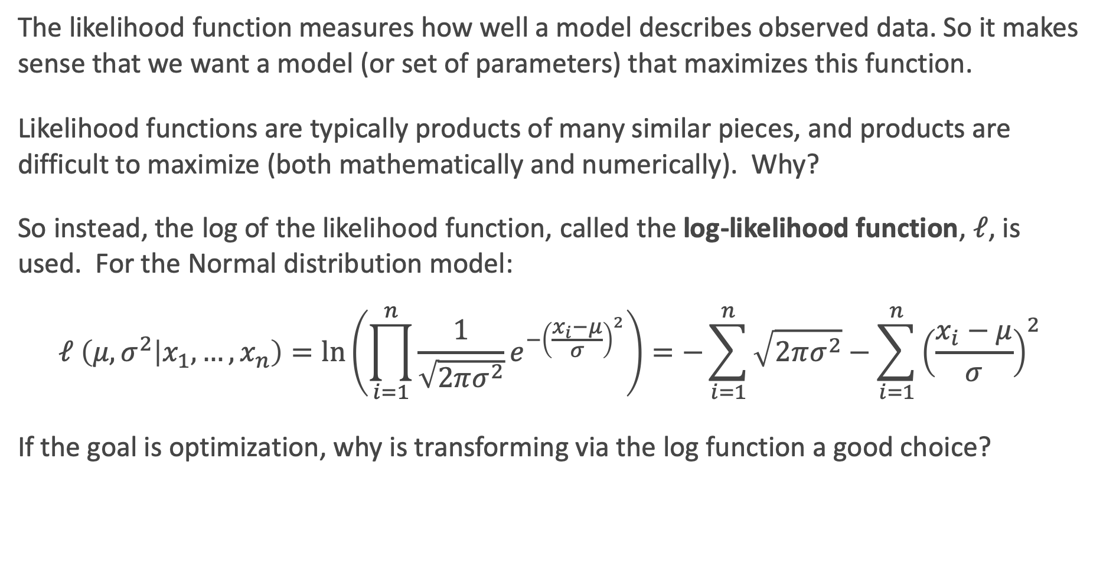
The log-likelihood
The likelihood function measures how well a model describes observed data. So it makes sense that we want a model (or set of parameters) that maximizes this function.
Likelihood functions are typically products of many similar pieces, and products are difficult to maximize (both mathematically and numerically). Why?
So instead, the log of the likelihood function, called the log-likelihood function, $ℓ$, is used. For the Normal distribution model:
$$ℓ \left(μ,σ^{2} | x_{1},…,x_{n}\right)=\ln\left(\prod_{i=1}^{n}{\frac{1}{\sqrt{2πσ^{2}}}e^{−{\left(\frac{x_{i}−μ}{σ}\right)}^{2}}}\right)=−\sum_{i=1}^{n}{\sqrt{2πσ^{2}}}−\sum_{i=1}^{n}{{\left(\frac{x_{i}−μ}{σ}\right)}^{2}}$$
If the goal is optimization, why is transforming via the log function a good choice?

Slide 18
Maximizing the likelihood
In order to choose the best Normal distribution to describe a set of data, we should maximize the likelihood that chooses the best set of parameters given the data.
The maximum likelihood estimates for a statistical model are those that maximize the likelihood function given the observed data.
How do we do this mathematically? How could we do this computationally?
With Math: ______________________________________________________
With Computers:__________________________________________________

Slide 19

Likelihood function example
3 observations are collected [3, 5, 10] that are thought to come from a normal distribution with unknown mean, $μ$, but is known to have a variance of $σ^{2}=2^{2}$ (yes, this is contrived).
Let’s plot the likelihood and log-likelihood functions:

Slide 20
Modeling Linear Regression Probabilistically

Slide 21
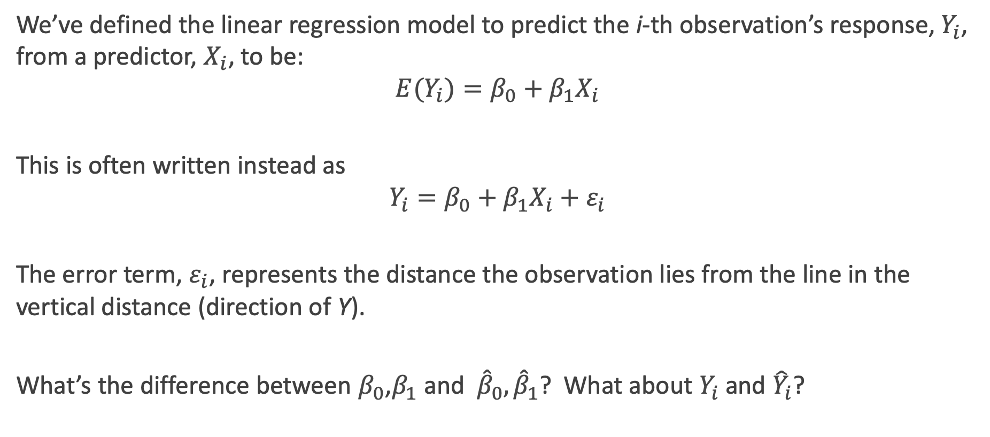
The Simple Linear Regression Model
We’ve defined the linear regression model to predict the i-th observation’s response, $Y_{i}$, from a predictor, $X_{i}$, to be:
$${E(Y}_{i})=β_{0}+β_{1}X_{i}$$
This is often written instead as
$$Y_{i}=β_{0}+β_{1}X_{i}+ε_{i}$$
The error term, $ε_{i}$, represents the distance the observation lies from the line in the vertical distance (direction of Y).
What’s the difference between $β_{0}$,$β_{1}$and ${\hat{β}}_{0},{\hat{β}}_{1}$? What about $Y_{i}$ and ${\hat{Y}}_{i}$?

Slide 22
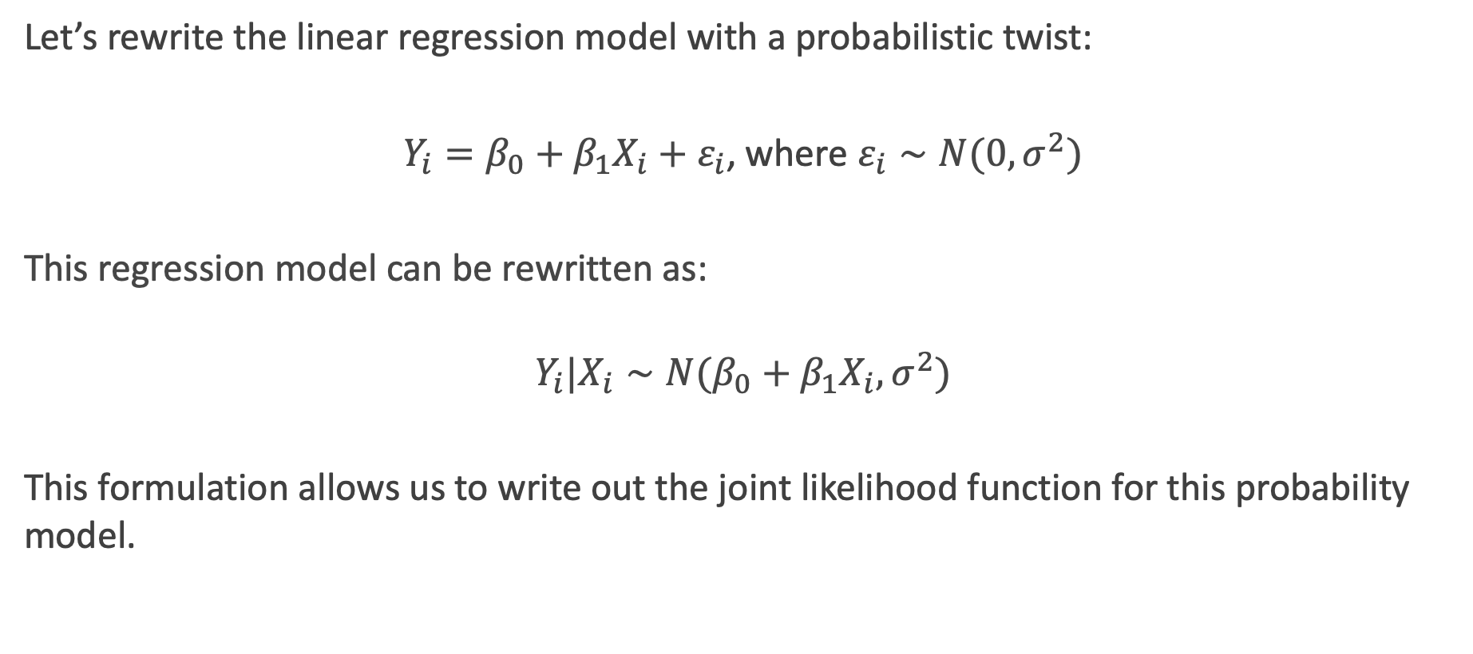
The Probabilistic Regression Model
Let’s rewrite the linear regression model with a probabilistic twist:
$Y_{i}=β_{0}+β_{1}X_{i}+ε_{i}$, where $ε_{i}∼N(0,σ^{2})$
This regression model can be rewritten as:
$$Y_{i}|X_{i}∼N(β_{0}+β_{1}X_{i},σ^{2})$$
This formulation allows us to write out the joint likelihood function for this probability model.

Slide 23
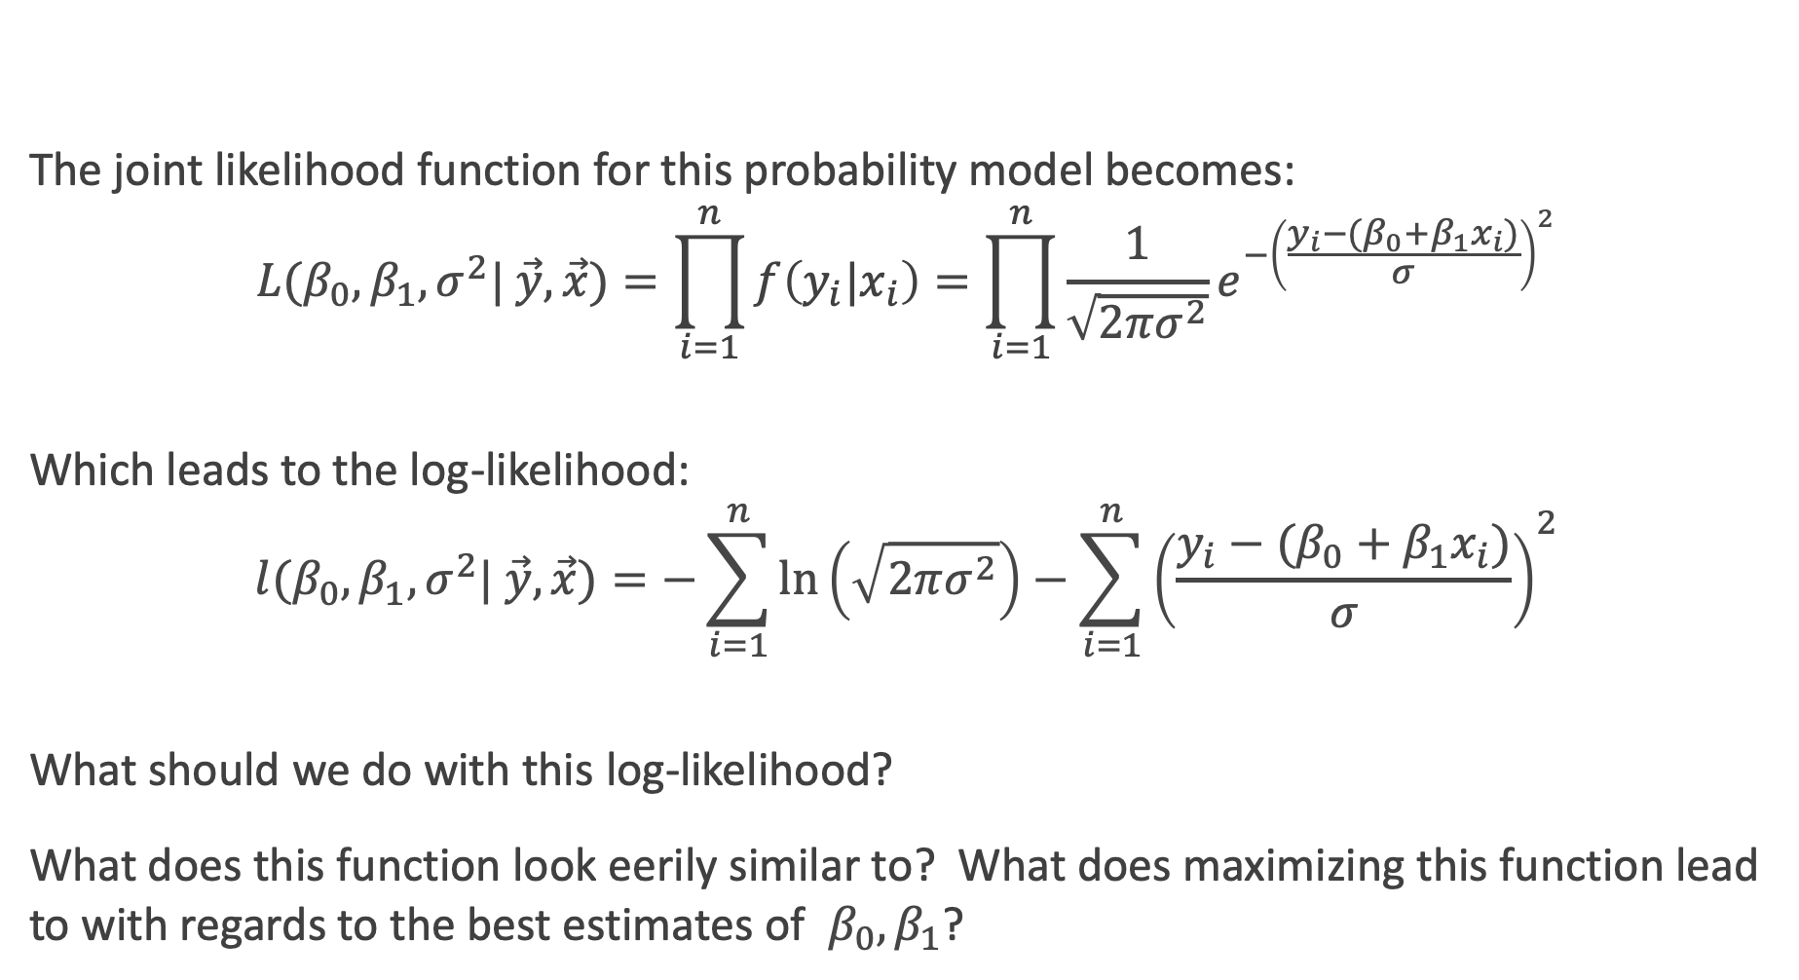
The Likelihood of Linear Regression
The joint likelihood function for this probability model becomes:
$$L(β_{0},β_{1},σ^{2}| \vec{y},\vec{x})=\prod_{i=1}^{n}{f\left({y_{i}|x}_{i}\right)}=\prod_{i=1}^{n}{\frac{1}{\sqrt{2πσ^{2}}}e^{−{\left(\frac{y_{i}−(β_{0}+β_{1}x_{i})}{σ}\right)}^{2}}}$$
Which leads to the log-likelihood:
$$l(β_{0},β_{1},σ^{2}| \vec{y},\vec{x})=−\sum_{i=1}^{n}{\ln\left(\sqrt{2πσ^{2}}\right)}−\sum_{i=1}^{n}{{\left(\frac{y_{i}−(β_{0}+β_{1}x_{i})}{σ}\right)}^{2}}$$
What should we do with this log-likelihood?
What does this function look eerily similar to? What does maximizing this function lead to with regards to the best estimates of $β_{0},β_{1}$?

Slide 24
Take home message
By taking a probabilistic approach to linear regression and assuming the residuals are normally distributed, we see that maximizing the likelihood for this model is equivalent to minimizing mean squared error around the line!
So if we believe our residuals are normally distributed, then minimizing mean square error is a natural choice.
But by choosing this specific probability model, we get much more than simply motivation for our loss function. We get instructions on how to perform inferences as well ☺

Slide 25
Checking the assumptions of this model:
The probabilistic model of linear regression leads to 4 main assumptions that can be checked with the data (the first 3 at least):
Linearity: relationships are linear and there is no clear non-linear pattern around the line (as evidenced by the residuals).
Normality: the residuals are normally distributed.
Constant Variance: the vertical spread of the residuals is constant everywhere along the line.
Independence: the observations are independent of each other.
Note: collinearity is not a violation of an assumption, but can certainly muck up the model.

Slide 26
Checking assumptions visually

Slide 27
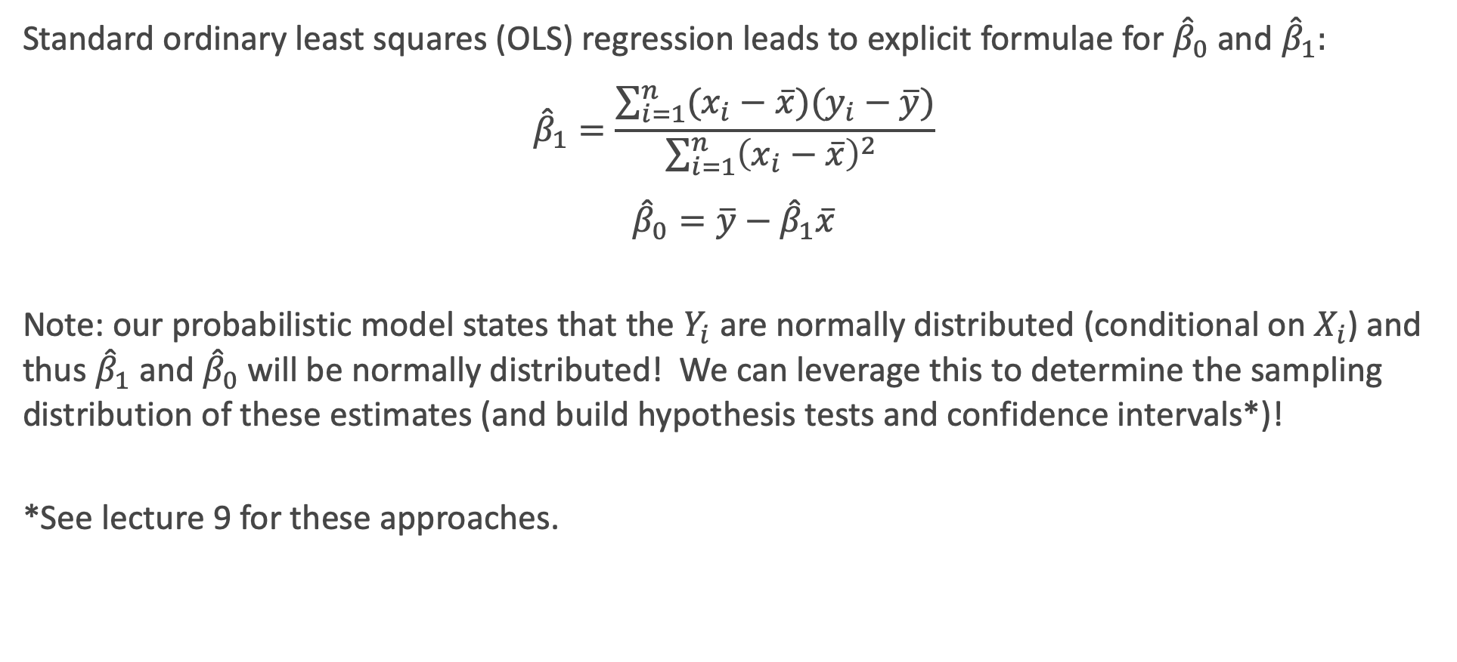
Reminder: Estimates of the slope and intercept
Standard ordinary least squares (OLS) regression leads to explicit formulae for ${\hat{β}}_{0}$ and ${\hat{β}}_{1}:$
$${\hat{β}}_{1}=\frac{\sum_{i=1}^{n}{(x_{i}−\overline{x})(y_{i}−\overline{y})}}{\sum_{i=1}^{n}{{\left(x_{i}−\overline{x}\right)}^{2} }}$$
$${\hat{β}}_{0}=\overline{y}−{\hat{β}}_{1}\overline{x}$$
Note: our probabilistic model states that the $Y_{i}$ are normally distributed (conditional on $X_{i}$) and thus ${\hat{β}}_{1}$and ${\hat{β}}_{0}$ will be normally distributed! We can leverage this to determine the sampling distribution of these estimates (and build hypothesis tests and confidence intervals*)!
*See lecture 9 for these approaches.

Slide 28
statsmodels

Slide 29
Fitting linear regression models in Python
There are two packages used to fit linear regression models in python.
sklearn: is great for getting estimates, doing predictions, integrating cross-validation, etc. Not so good for confidence intervals or hypothesis testing (it’s machine learning, not statistics).
statsmodels: is great for statistical inference (confidence intervals and hypothesis testing) but not as good at the other things
Which to use depends on the goal of modeling.

Slide 30
OLS in statsmodels

Slide 31
Exercise Time! Ex. 1: Normal Distributions and Likelihoods (15 min) Ex. 2: Linear Regression in statsmodels (15+ min)

Slide 32
Ex. 1: Normal Distributions and Likelihoods

Slide 33
Ex. 2: Linear Regression in statsmodels

